Slide 1


Simulations of Convective Flash Flood Events in Southern Switzerland
Camden Plunkett
Curtis James, Embry-Riddle Aeronautical University-Prescott
Arizona Space Grant Symposium, Tempe, AZ
April 22, 2017

Slide 2
Background
Climatological precipitation maxima in the Alps coincide with concavities in the terrain
Gain further insight into why thunderstorms frequently initiate and move across the same area (known as convective echo training), leading to flash flooding
Simulating 9 events using the Weather Research and Forecasting (WRF UEMS) Model

Slide 3
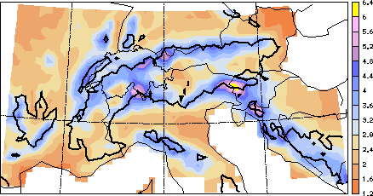
Climatological Precipitation in European Alps
Lago Maggiore region
Taken from Frei and Schär (1998)

Slide 4
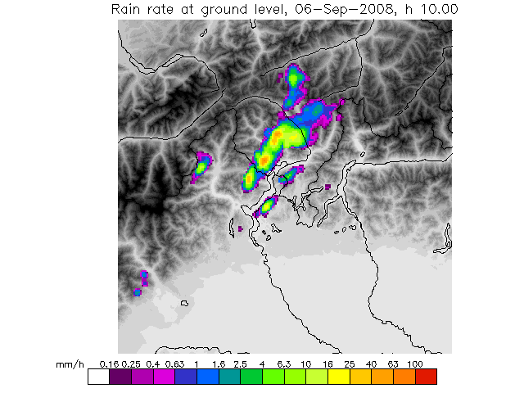
Radar Showing Echo Training

Slide 5
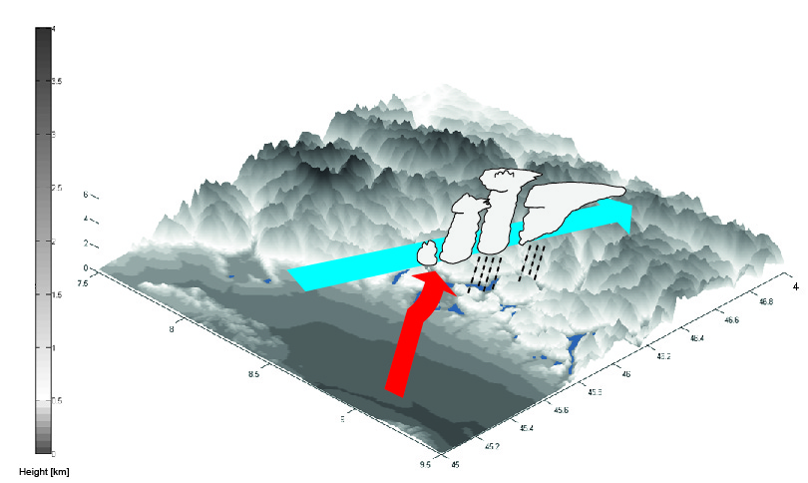
Conceptual Model of Echo Training and Flash Flooding
Taken from Panziera et al. (2015)

Slide 6
Methodology
Used the WRF UEMS to simulate 9 convective flash flood events previously studied by Panziera et al. (2015)
Model verification performed by comparing simulated precipitation to radar-estimated precipitation, and simulated vertical profiles to weather balloon observations from Milan, Italy
7 simulations showed agreement with observations
Temporal averaging of model output fields used to gain insight into the mean atmospheric characteristics when echo training occurred

Slide 7
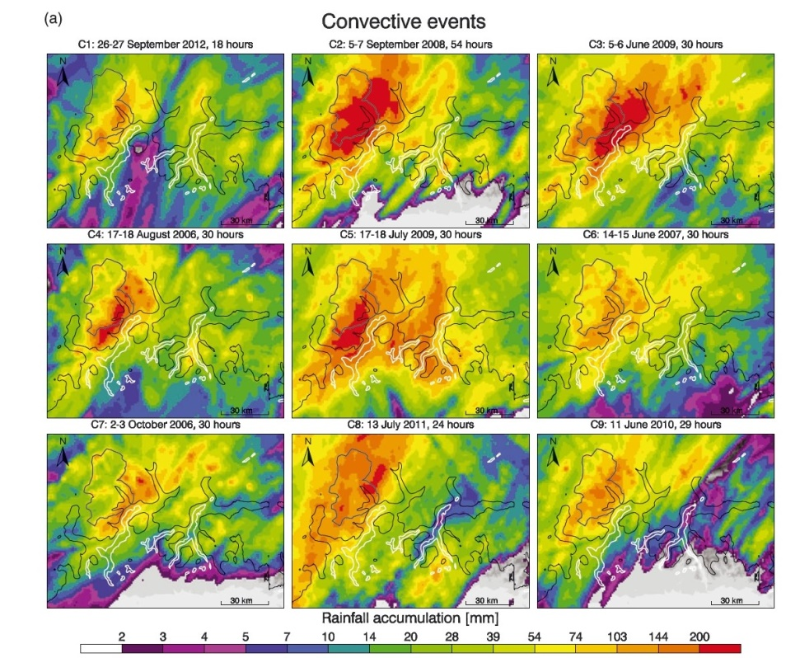
Observed Rainfall
Elliptical precipitation maximum located over foothills of Alps above Lago Maggiore
Taken from Panziera et al. (2015)

Slide 8
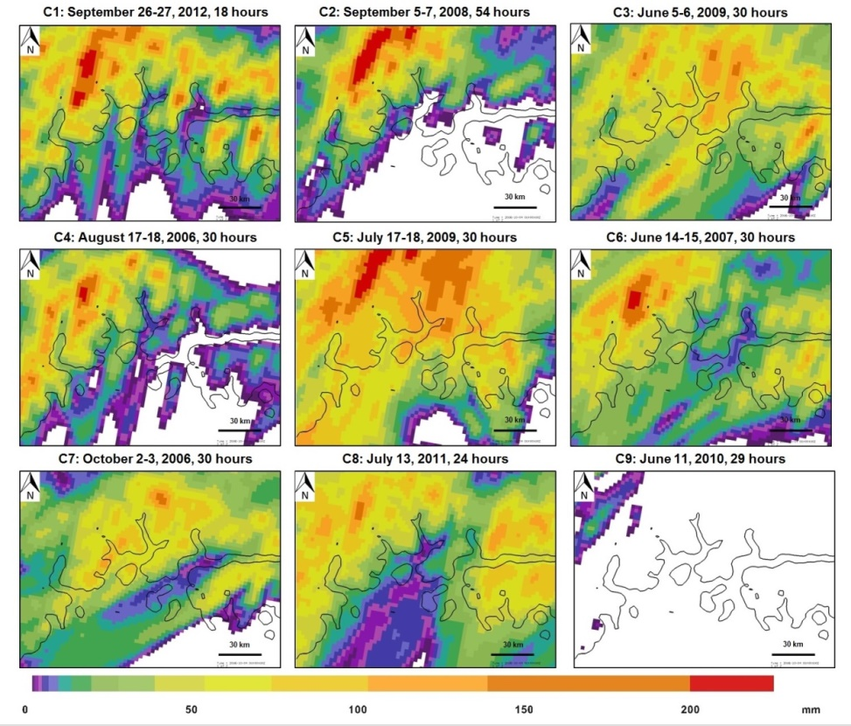
Model Simulated Rainfall
Elliptical precipitation maximum observed in 7 of 9 simulations

Slide 9
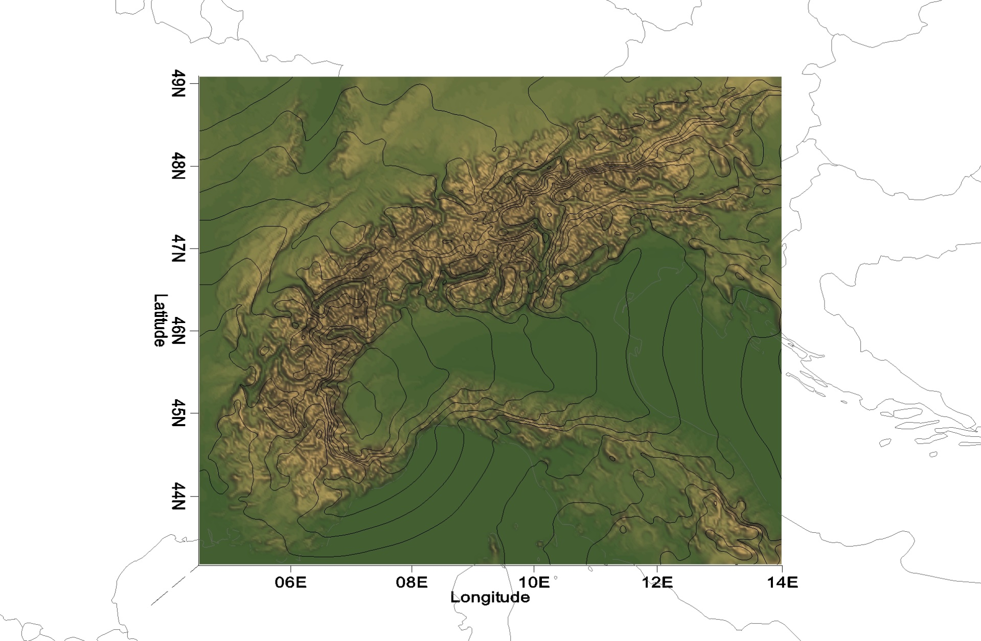
Mean Sea Level Pressure
L
Isobars at 0.5 hPa interval showing low over Piedmont region of Italy. Winds rotate counterclockwise around the low.

Slide 10
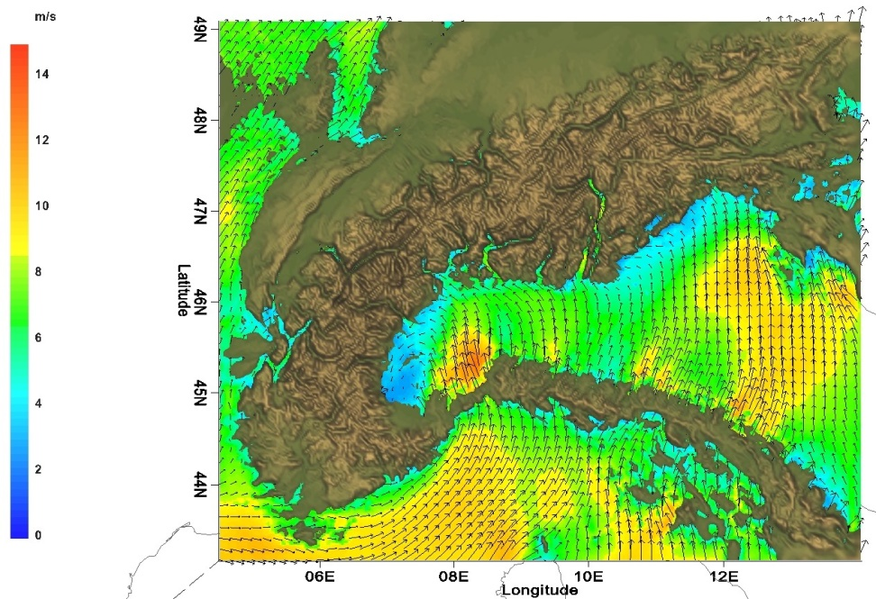
0.5-km MSL wind vectors & speed
Barrier Jet
L
Low-level Jet
Southerly low-level jet, and easterly barrier jet converge in Lago Maggiore region

Slide 11
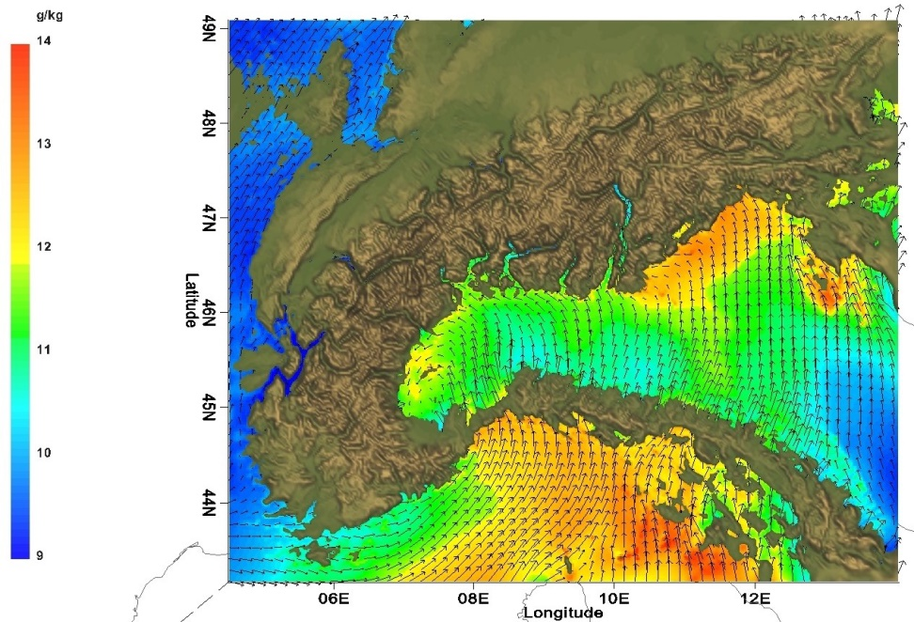
0.5-km MSL wind vectors and moisture
L
Moisture directed northward into Lago Maggiore region by southerly low-level jet

Slide 12
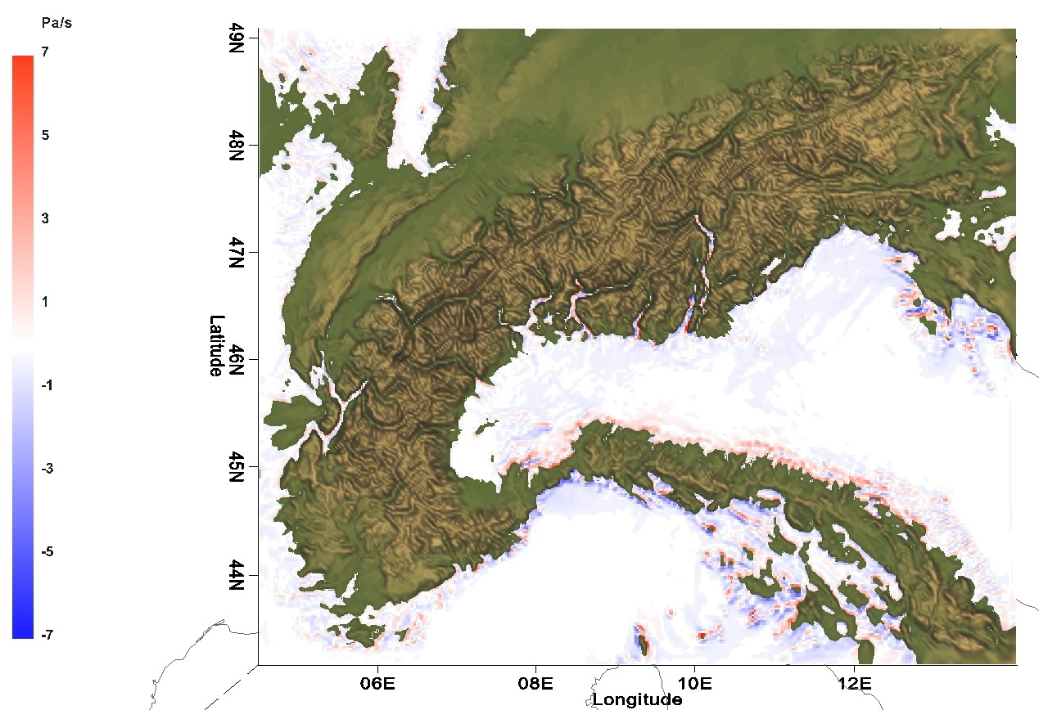
0.5-km MSL vertical motion
Low-level wind flows downslope to lee (north) of the Apennines indicated by red shading

Slide 13
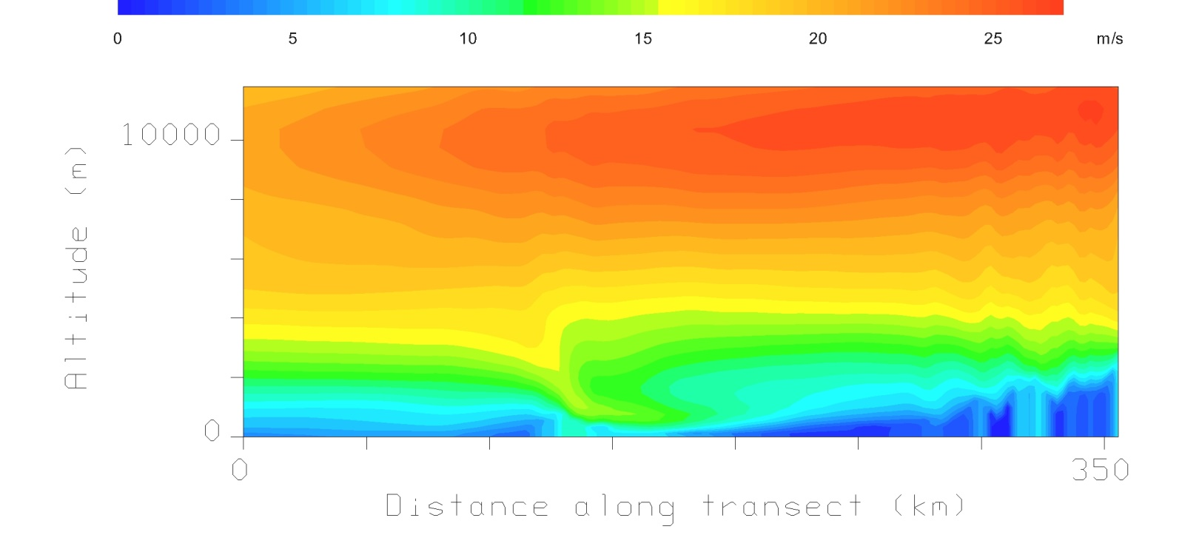
Vertical Cross Section of Meridional Wind
Vertical cross section through the low-level jet of the north-south component of the wind
Black shading is a vertical cross section of the model terrain
Downsloping winds are clearly evident in the figure just north of the Apennines

Slide 14
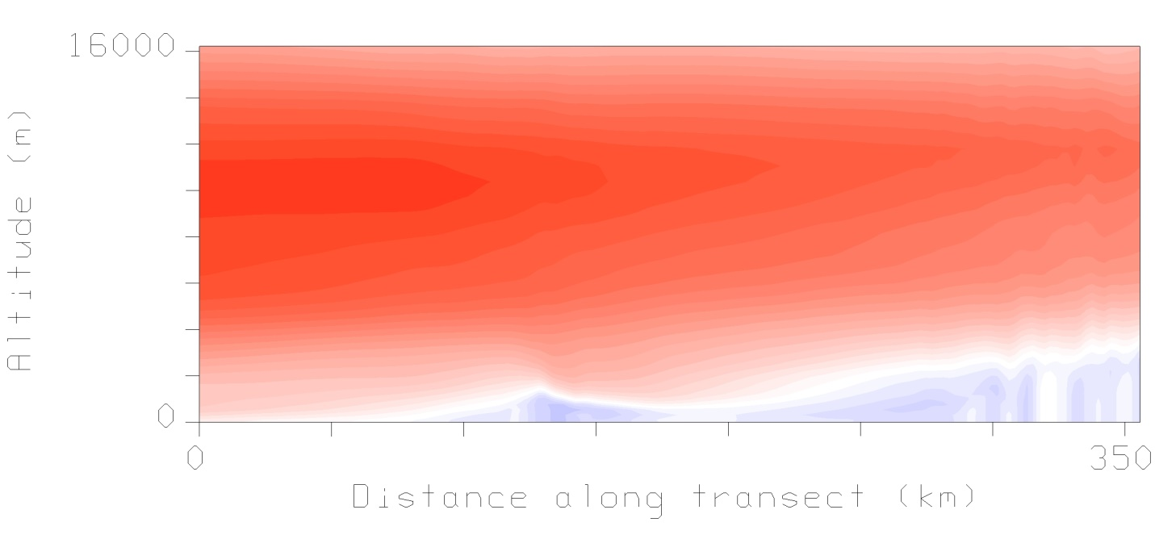
Vertical Cross Section of Zonal Wind
Vertical cross section through the low-level jet of the west-east component of the wind
Easterly winds (moving westward) are clearly evident (blue shading) in the figure upstream of the Apennines and the Alps, which indicates deflection of the flow and a barrier jet

Slide 15
Conclusions
My research helps reveal causes of echo training and flash flooding in the southern Alps
Evidence of a Mediterranean low-level jet from the south converging with a barrier jet from the east is likely triggering thunderstorms
The wind patterns are affected by a persistent local low pressure system in far northwestern Italy
Downsloping is observed on the north of the Apennines, which dries the air and thus aids to deflect the flow into an Alpine barrier jet

Slide 16
Acknowledgements
Luca Panziera, University of Bern (Switzerland)
Marc Collins, ERAU-Prescott
Austin Wardall, ERAU-Prescott
Gary Yale, ERAU-Prescott Space Grant

Slide 17
Questions?

